Slide 1


Multi-ClientGame System
TEAM LEADER :
Name : Rishab Acharjee Roll No : 22CS8071
MEMBERS :
Name : Sangam Revathi Roll No : 22CS8072
Name : Aniruddha Mondal Roll No : 22CS8073
Name : Supam Roy Roll No : 22CS8074
Name : Chiluvuru Bala shanmukha Sri Krishna Roll No : 22CS8075
Name : Shib Shankar Sharma Roll No : 22CS8076
Name : Varshitha Yadlapalli Roll No : 22CS8077
Name : Rahul Verma Roll No : 22CS8078
Name : Sannidhanam Vidya Charan Roll No : 22CS8079
Name : Anisha Gupta Roll No : 22CS8080
Notes:
1

Slide 2


TCP Socket Connection
Data Integrity
Ensuring reliable data transmission.
1
Latency Concerns
Minimizing delays for smooth gameplay.
2
Scalability Issues
Handling many concurrent players efficiently.
Problem Description
TCP-based Client-Server Quiz Application with multithreading for handling multiple clients.
User authentication, timed quiz rounds, and real-time feedback and scoring provided to each client.
Scoring includes penalties for incorrect or missed answers, with final scores sent to clients.
Extra Buzzer Round Quiz
Alternating Quiz With Option To Challenge
Notes:
2

Slide 3
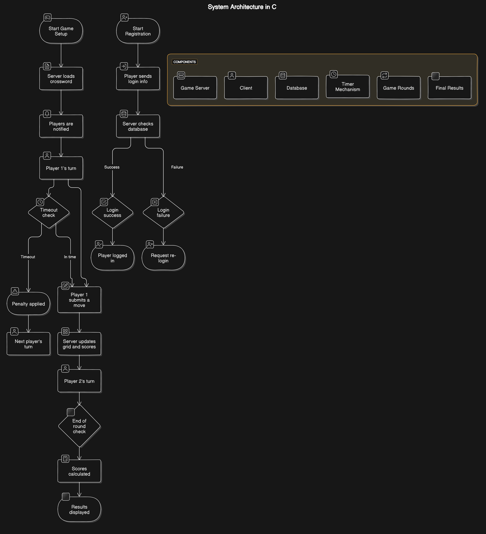
System Architecture
Client-Side
Handles user interface and input.
Server-Side
Game logic, networking, and data management.
Database
Persistent storage for player data.
Game Server
Manages game state and player interactions.
Notes:
4

Slide 4
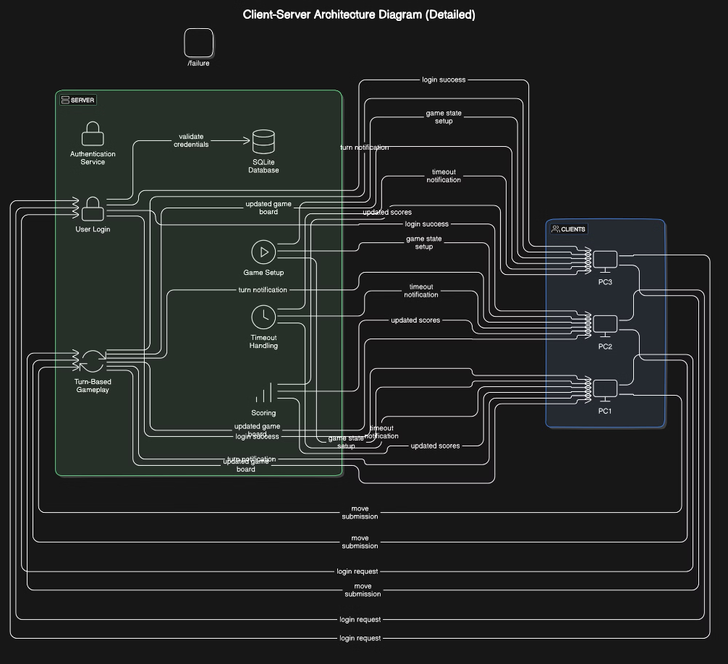
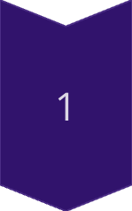
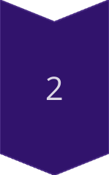
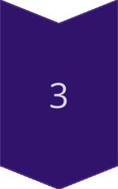
Client-Server Relationship
Client Request
Player sends input to the server.
Server Processing
Server updates game state.
Server Response
Server sends updates to the client.
Notes:
5

Slide 5
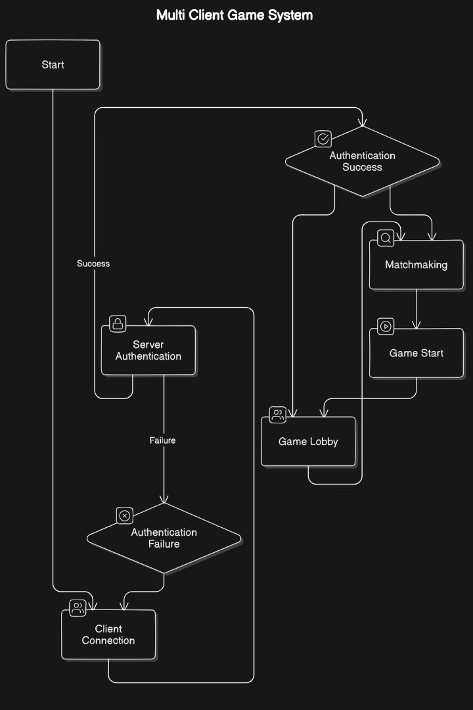
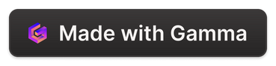
Component Flowchart
Player Input
1
Client sends player actions.
Server Processing
2
Server validates and processes.
Game Update
3
Server broadcasts changes.
Client Rendering
4
Client updates display.
Notes:
7

Slide 6
Server Functionality
Connection Management
Game Logic
Data Persistence
1
2
3
Implements game rules and updates the game state.
Saves and loads game data to the database.
Handles client connections and disconnections.
Quiz with alternation, challenges, and session management
Extra Buzzer Round Quiz
4
5
Scoring Scheme
6
Correct Answer : 10 points
Incorrect Answer
Normal : 0 points
Challenge : -10 points
Quiz server with Buzzer round: rewards the fastest correct answer.
Two players alternate answers on separate client instances.
Notes:
8

Slide 7
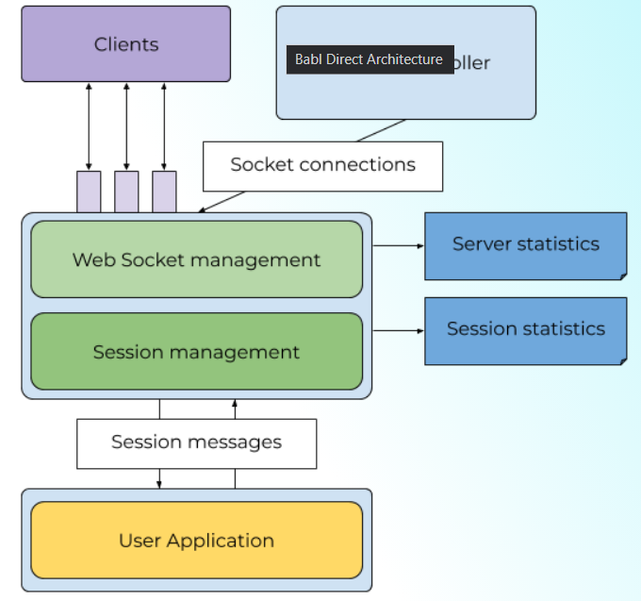
Networking Sockets
TCP
Connection-oriented, reliable
Sockets
Endpoint for network communication
Ports
Unique identifiers for applications
Notes:
9

Slide 8
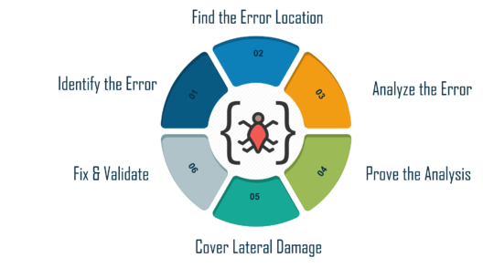



IMPLEMENTATION CHANGES
Implementation Challenges
Debugging
Identifying and fixing errors.
Security
Protecting against vulnerabilities.
Optimization
Improving performance and scalability.
Notes:
10

Slide 9
Conclusion
TCP Multi-Client Game System enables real-time, reliable multiplayer gameplay using TCP socket programming.
Multi-threaded server architecture efficiently handles multiple clients, ensuring smooth gameplay and data integrity.
Provides a scalable and secure multiplayer environment with potential for future scalability and security enhancements.
Notes:
11

Slide 10
THANK YOU
Notes:
11

